Slide 1

Category
Prediction
OF
YouTube
Videos
By:
Ali Zamani
Soroush Esfehanian
Fereshte Bagheri

Slide 2




Table of Content
01
02
03
04

Slide 3
1

Slide 4
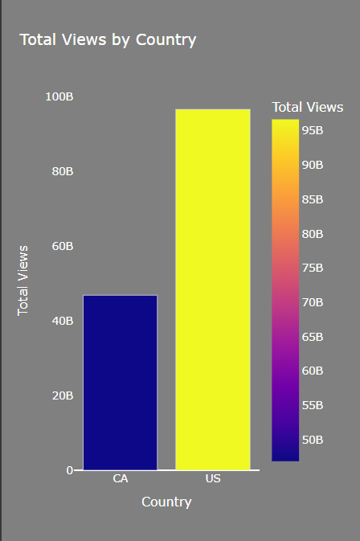
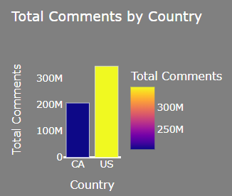
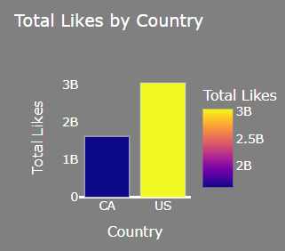
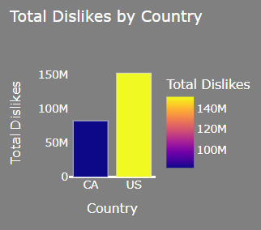
Country
------------
------------
CA
US
40881 trending videos from
2008-01-13 to
2018-06-14
------------
40949 trending videos from
2006-07-23 to 2018-06-14
------------

Slide 5
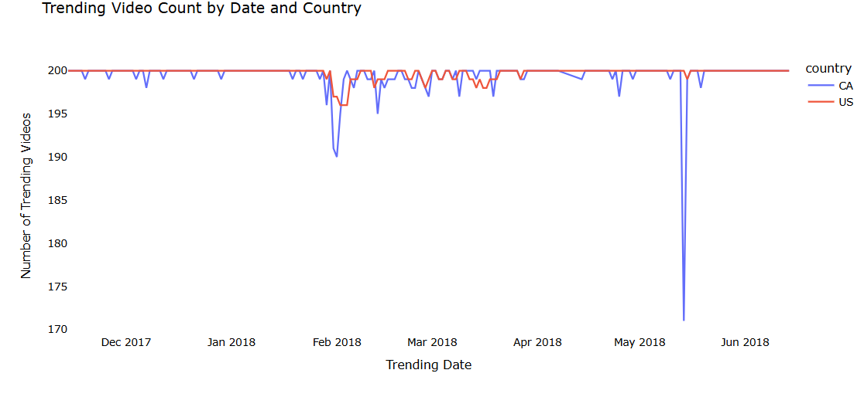

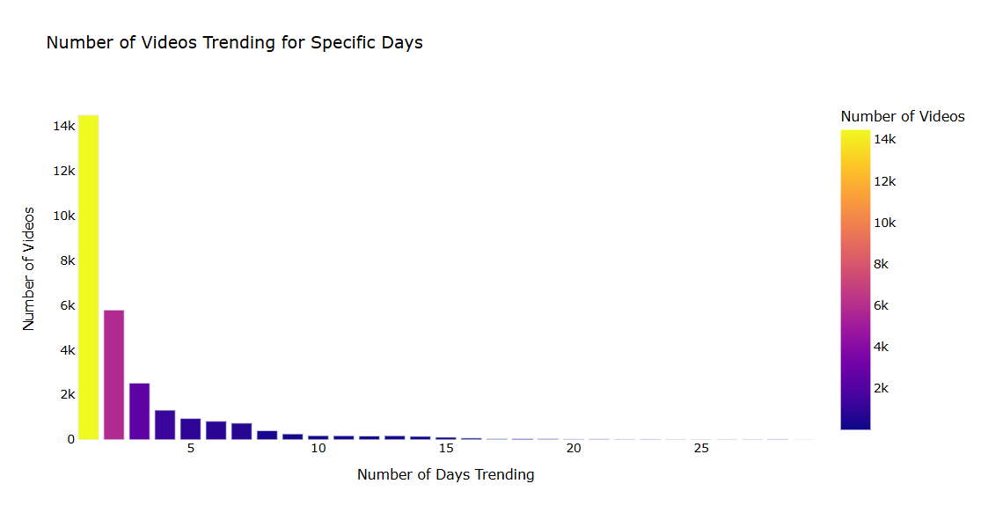
Country
Video Id,
Trending Date
------------
------------
------------
------------
The most trending period in the dataset was 29 days, with 126 videos from popular channels such as SamSmithWorldVEVO, Lucas and Marcus, Unbox Therapy, and Selena Gomez trending during this period.
------------
------------
@Smosh
@Smosh
@Smosh
@Smosh

Slide 6
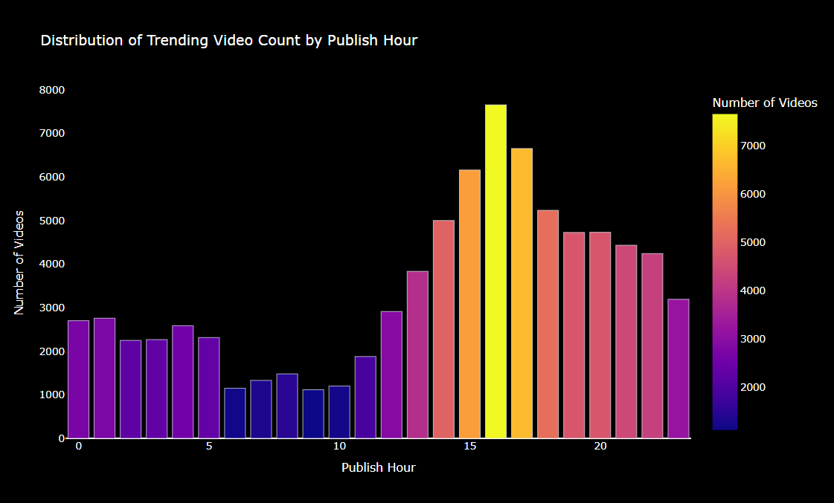
What is the best time to publish a video?
Country
Video Id,
Trending Date
Publish Time
------------
------------
------------
------------
------------

Slide 7
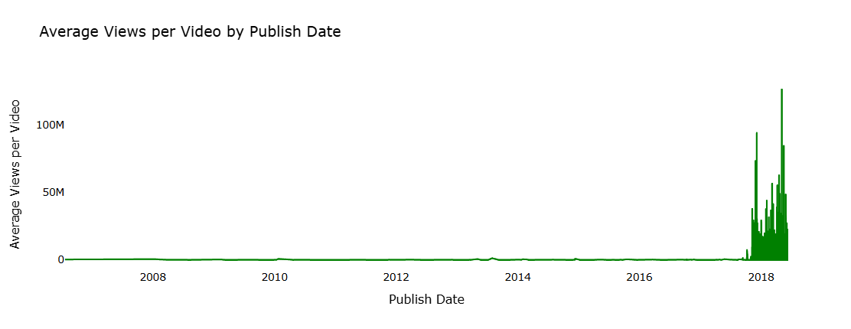
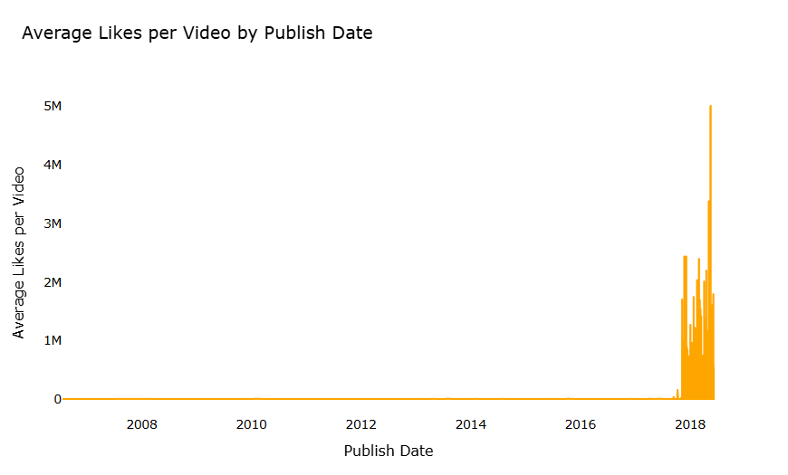
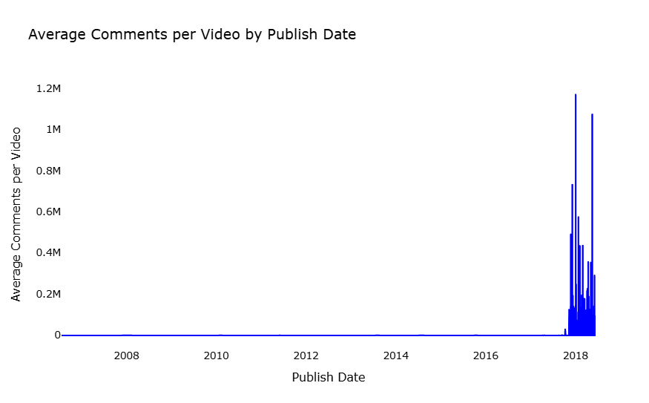
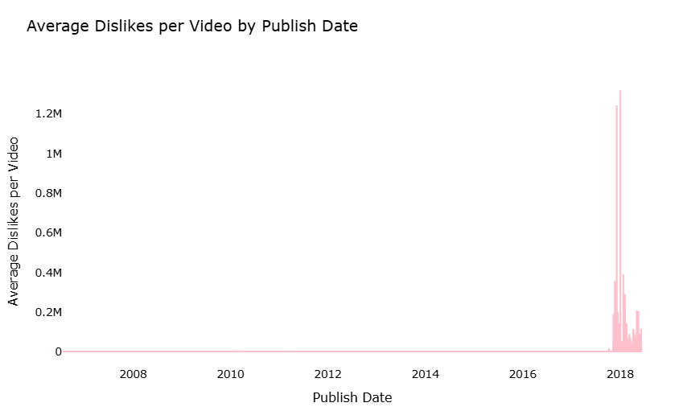
143B Views!
Country
1
4
3
5
6
3
7
4
5
2
2
1
Video Id,
Trending Date
Publish Time
View, Like, Dislike
& Comment
------------
143,563,745,221
Creator 3
------------
------------
------------

Slide 8
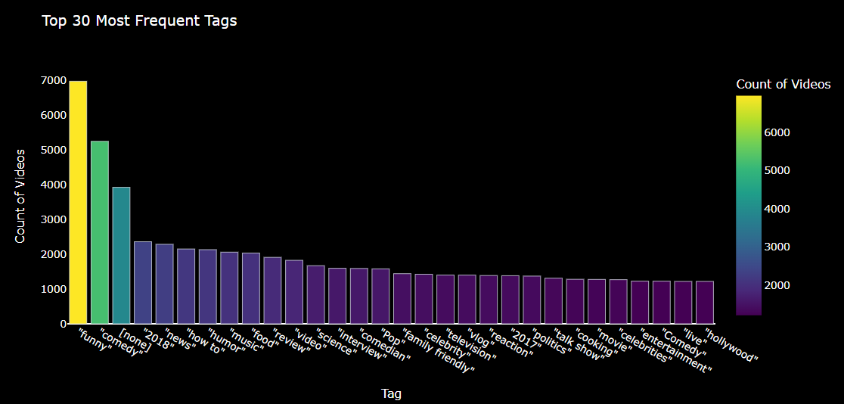
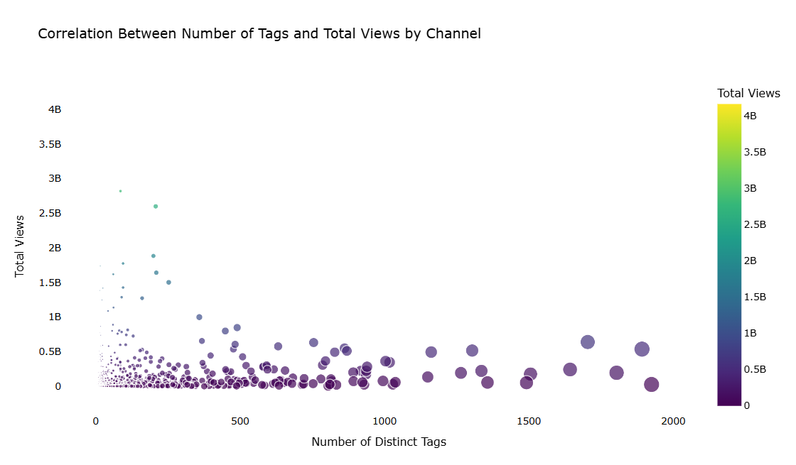
Country
Video Id,
Trending Date
Publish Time
View, Like, Dislike
& Comment
tags
------------
------------
------------

Slide 9
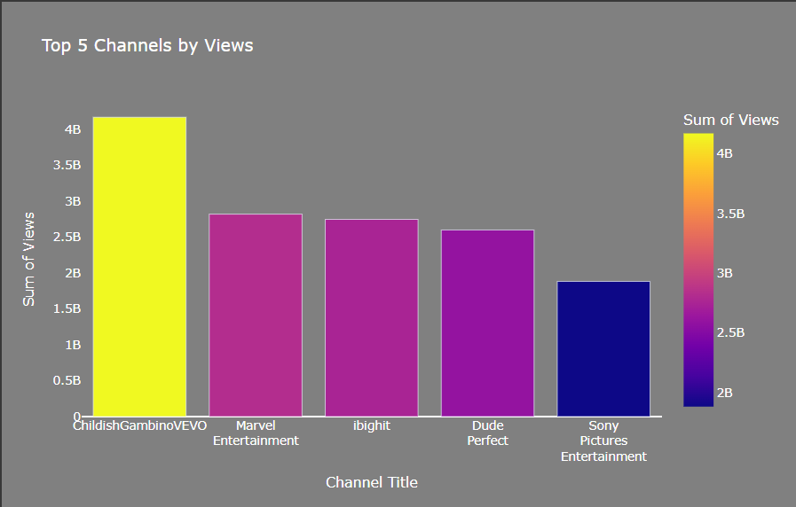
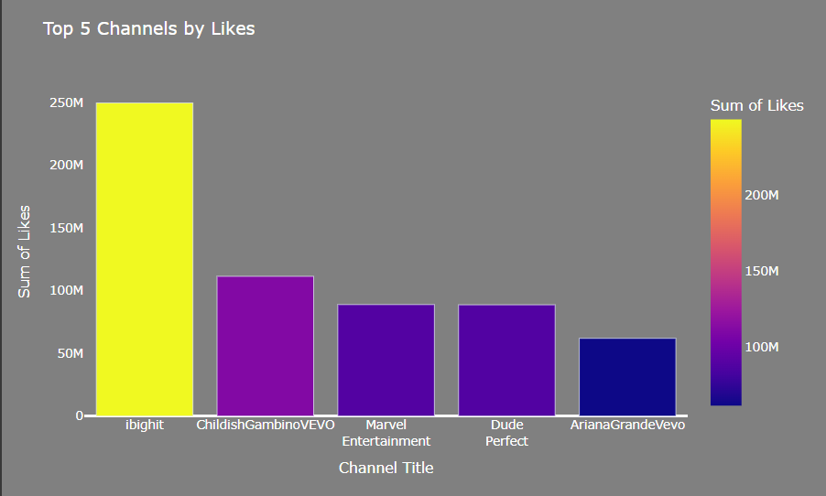
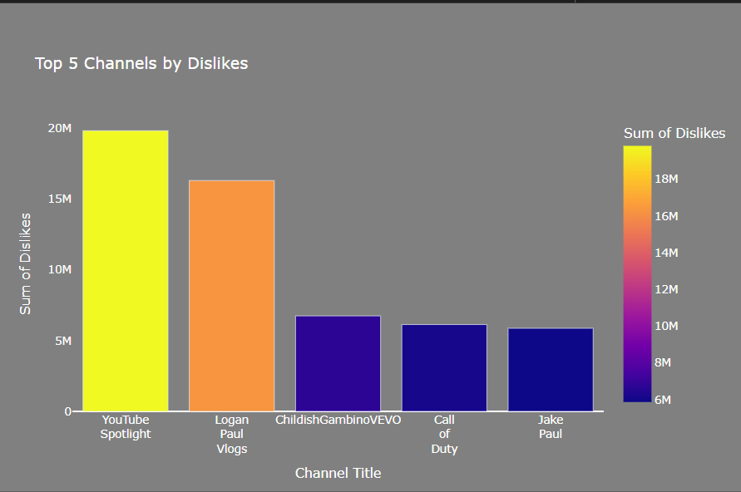
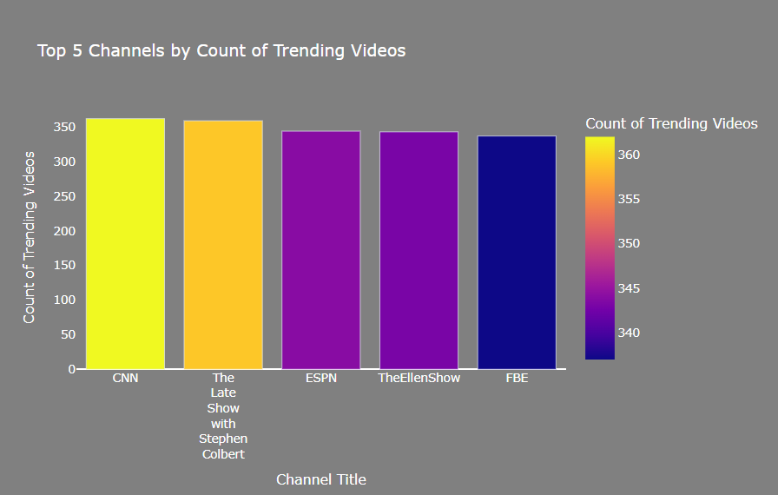
Country
Video Id,
Trending Date
Publish Time
View, Like, Dislike
& Comment
tags
Channel Title
------------
------------

Slide 10
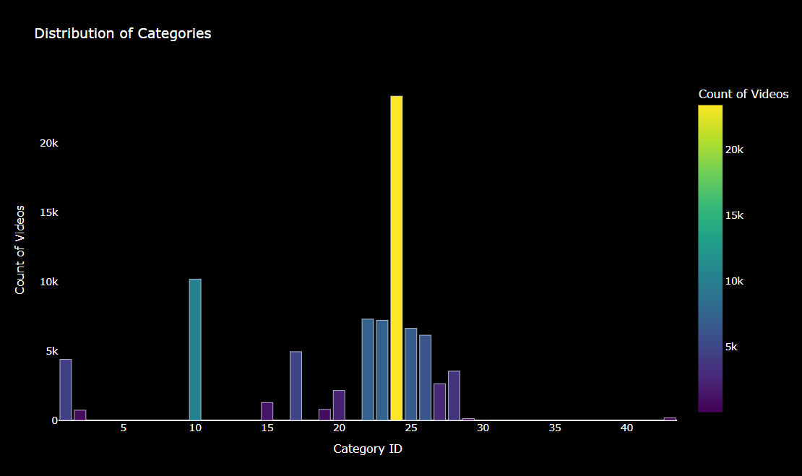
Country
Video Id,
Trending Date
Publish Time
View, Like, Dislike
& Comment
tags
Channel Title
Category Id
------------

Slide 11


📊 The Pipeline
All
Music
Gaming
Live
Lo-fi
Accept train or test mode as input.
In train mode:
Load and merge raw YouTube data.
Perform feature engineering (e.g., tag parsing, time extraction).
Preprocess data (cleaning, encoding, normalization).
Split data into training and validation sets.
Train classification model to categorize videos.
In test mode:
Load trained model and prepare test data.
Make predictions on new/unseen videos.
Pipeline of trending YouTube video categorization
UT
Subscribe
Share
Save
Data Science

Slide 12
2

Slide 13




Feature
Engineering
Text Embedding Creation:
A variant of the BERT encoder is utilized.
Description, Tags and Title mapped to a 384-d vector.
Embeddings are later replaced in the dataset.
New Feature Creation:
Engagement Ratio
Tag Count
Like-Dislike Ratio
Miscellaneous:
Boolean-Numeric Conversion
Categorial Encoding
Date Parsing
Text Embedding Replacement
New Feature Creation
Categorical Encoding
Date Parsing
Boolean Conversion
Next: Preprocess

Slide 14


Pre-process
Drop Low Variance Features:
comments_disabled, ratings_disabled and video_error_or_removed.
Ratio more than 99%
Drop correlated features:
Likes-views
Dislikes-views
Likes-Dislikes
Miscellaneous:
Drop NaN
Drop duplication
Normalization
Standardization
Drop Low Variance Features
Drop NaN And Duplications
Drop correlated features
Normalization & Standardization

Slide 15
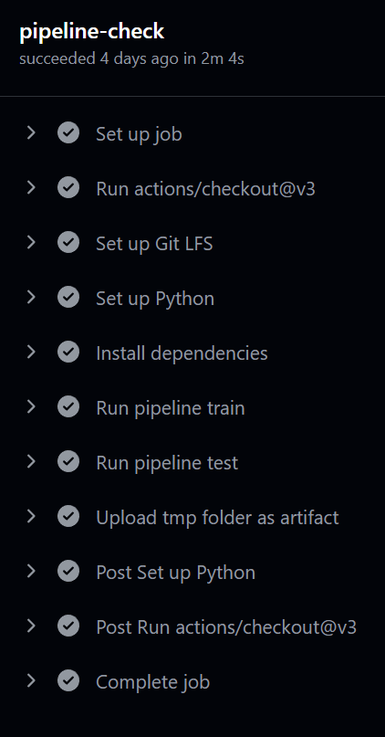
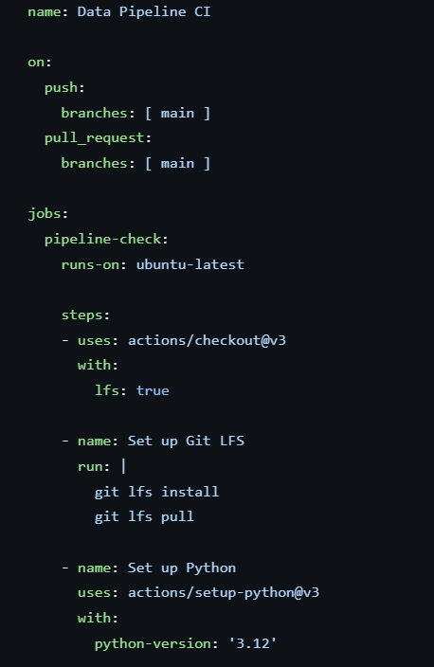
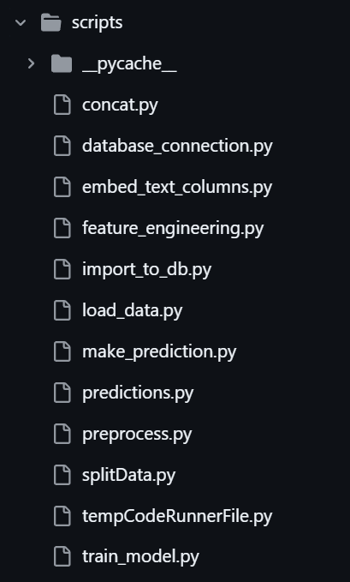
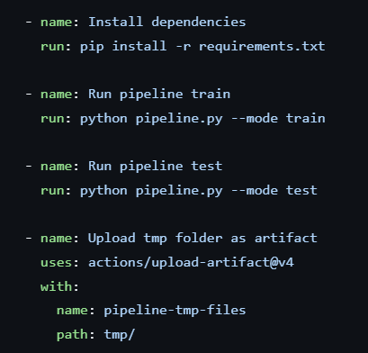
The Pipeline

Slide 16
3

Slide 17
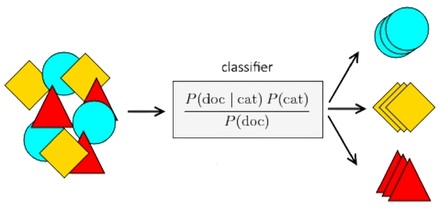
Gaussian Naive Bayes
Models each feature as a class-conditional Gaussian and uses Bayes’ theorem with a conditional independence assumption to compute posterior probabilities, yielding a fast generative classifier that’s often a strong baseline.
Gaussian Naïve Bayes
------------
SimpleImputer.strategy: 'mean'
------------
------------
priors:
None
------------
var_smoothing :
1e-9
train_test_split.stratify:
y

Slide 18
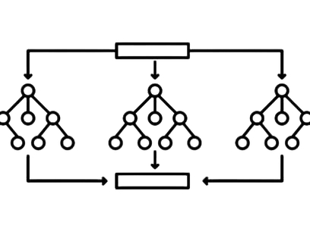
XGBoost Classifier
An ensemble of decision trees built iteratively using gradient boosting with second-order optimization. At each round, new trees are added to correct the errors of the existing ensemble, minimizing a regularized objective. XGBoost excels on heterogeneous, high-dimensional, tabular data by automatically learning complex feature interactions and handling missing values natively, yielding a fast and accurate multiclass classifier.
Gaussian Naïve Bayes
XGBoost Classifier
------------
Objective: 'multi:softprob'
------------
------------
eval_metric: 'mlogloss'
use_label_encoder: False
early_stopping_rounds: 10

Slide 19
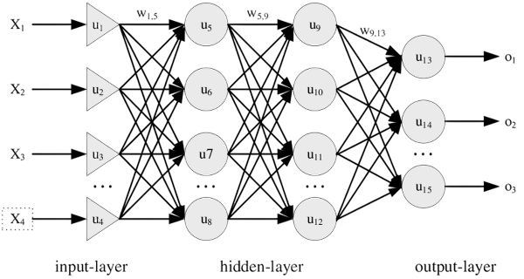
Single-Branch MLP
A flat feed-forward neural network that concatenates all title, tags, and description embeddings with numeric features, passes them through two wide hidden layers (512→256 units) with 50% dropout, and uses a softmax output to perform multiclass video categorization, optimized with Adam and governed by early stopping on validation loss.
Gaussian Naïve Bayes
XGBoost Classifier
Single-Branch MLP
Objective: 'multi:softprob'
------------
------------
eval_metric: 'mlogloss'
use_label_encoder: False
early_stopping_rounds: 10

Slide 20
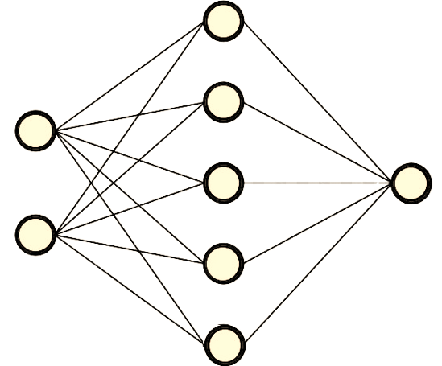
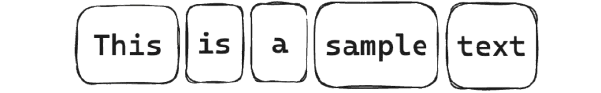
3Branch MLP
Gaussian Naïve Bayes
Category Prediction
283000+ Parameters
XGBoost Classifier
Single-Branch MLP
Stratification: ✅
Numeric Features
3Branch MLP
For each branch:
A 128-node layer
0.3 Dropout layer
Concatenation:
Two dense layers: 256 and 128 nodes followed by the output layer
------------
Description
Tags
Title

Slide 21
Category Prediction
3Branch MLP
Numeric Features
Description
Tags
Title

Slide 22

Pre-trained LLM
We utilized the meta-llama/Llama-3.3-70B model via API since our data was text-based. The model was used to predict category. This approach was implemented on 220 random selected samples. (due to rate and budget limit)
Gaussian Naïve Bayes
XGBoost Classifier
Prompt:
"You are an AI model that predicts the most appropriate YouTube video category for a given video. You will be provided with the video's title, tags, and description. Your task is to strictly select one category from the following list:
f"{', '.join(category_mapping.values())}\n\n Respond with only the category name, exactly as it appears in the list. Do not explain your reasoning. Output only the category name."
Sample-selection:
Random
Single-Branch MLP
3Branch MLP
model:
Meeta-llama/llama-3.3-70B
Pre-trained LLM
Number of samples:
220

Slide 23
4

Slide 24
Results
Recall | Precision | Accuracy
56.42% | 61.78% | 56.63% | Bayesian
47.72% | 69.96% | 64.39% | XGBoost
66.04% | 66.73% | 66.10% | MLP
75.78% | 78.98% | 78.91% | 3Branch MLP
- | - | 62.1% | Pretrained LLM
The 3Branch MLP model surpasses other models in all three metrics, demonstrating its ability to comprehend the embedded textual features.

Slide 25

Conclusion & Application
The Dataset of “trending YouTube videos” across US and Canada was utilized for the task of Category Prediction.
A 3-Branch MLP model was proposed to effectively learn the semantic of three embedded textual features.
The model surpassed simpler models such as ML models, a vanilla MLP, etc. and was able to surpass the pretrained LLM as well, obtaining a promising 78.9% accuracy on the data.
The model can be used for real world applications such as Recommendation Systems, use in Commercial Advertising, User Profiling, etc.

Slide 26
Thanks

